Slide 1
Google Analytics
Milee Singh Ashawad
CS688 C1 Web Analytics and Mining (Fall 2016)

Slide 2

FOODIE SEARCH
Foodie Search help in finding nearby restaurant locations.
Provide detailed information of the restaurant like contact, address as well as reviews.
Feedback form for user to provide comments.
Google Maps is integrated with the application to provide direction from current to restaurant location.
https://mileesingh.azurewebsites.net

Slide 3
HOMEPAGE

Slide 4
SEARCH

Slide 5
FEEDBACK

Slide 6
Dashboard

Slide 7
Dashboard

Slide 8
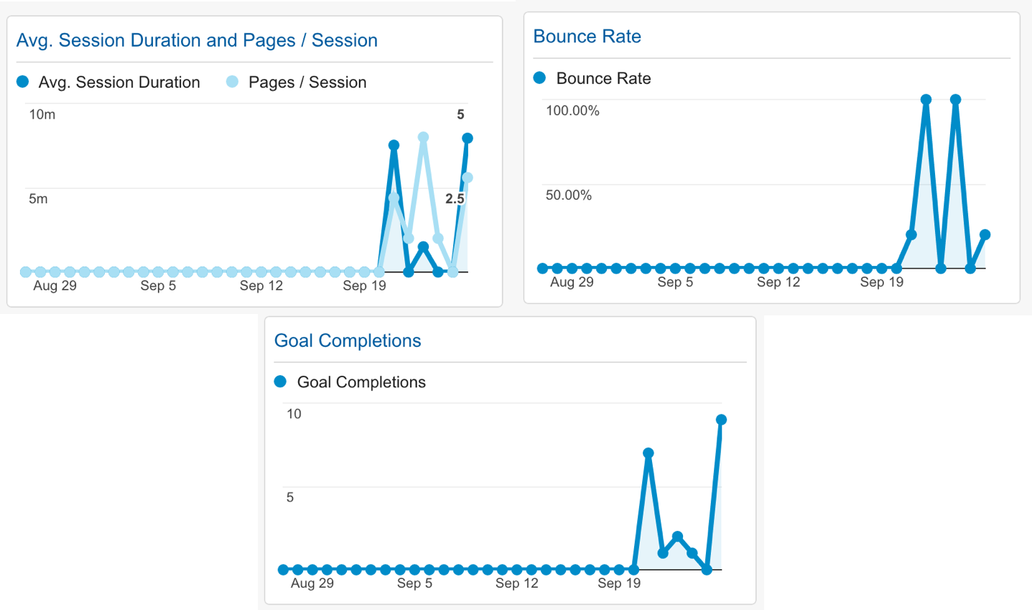
Dashboard

Slide 9
Real Time: Overview

Slide 10
Audience: Overview

Slide 11
Behavior : User Type

Slide 12
Demographic

Slide 13
Goals
Duration
Read reviews
01
04
The duration for which user view the pages
Gives information about the users viewing the top reviews for restaurant
02
Feedback
05
Yelp
Occurred when user successfully submits the feedback page
Requesting the yelp API
03
Pages/Session
Number of pages viewed per session

Slide 14
Goals

Slide 15
Goal 1 : Duration
Description
Duration track every visit that’s below a specific amount of time

Slide 16
Goal 2 : Feedback
Description
Feedback event gets fired if user successfully submits the feedback form
Code Snippet
ga('send','event','feedback','click','feedback'); $("#dialog-form").dialog("close");

Slide 17
Goal 3 : Pages/Session
Description
This goal tracks the number of pages each visitor sees before leaving the web application

Slide 18
Goal 4 : Read Reviews
Description
Read Reviews is called when user views the top reviews
Code Snippet
<button ng-click="showmore(place.id)" onclick="ga('send','event','review','click','review');" class="btn btn-primary"> View More </button>

Slide 19
Goal 5 : Yelp
Description
Yelp gets fired : application is loaded
Also when user clicks on find button
Code Snippet
YelpSearchFactory.getData(id).then(function (data) { ga('send','event','yelp','click','yelpbusiness'); $scope.busdata = data; window.openmore(); });

Slide 20
Goal Completions

Slide 21
THANK YOU
Milee Singh Ashawad
CS688 C1 Web Analytics and Mining (Fall 2016)

